Slide 1
Domain name : Software
Problem Statement Title: Rural Awareness and Accessibility of Tamil Nadu Government Schemes (Problem 35)
Team Name: Static Squad
Team Head: Jashwanth G
Project Title: Thitta-Murasu (திட்ட முரசு - The Scheme Announcer)

Slide 2
TITLE OF THE IDEA & ABSTRACT
The Idea: "Thitta-Murasu" is a centralized, A capable dashboard designed exclusively for Panchayat officials to proactively identify and notify eligible scheme beneficiaries.
How it addresses the problem: It bypasses the rural digital divide. Instead of expecting unconnected citizens to search for schemes, the local government uses this tool to push information directly to them.
Innovation & Uniqueness: Reverses the standard model from "citizen-seeking-scheme" to "scheme-seeking-citizen." It requires zero internet, smartphone, or digital literacy from the rural public.

Slide 3
OBJECTIVE :
Proactive Digital Inclusion: To empower rural citizens by providing timely access to government schemes without requiring them to have personal smartphones, internet connectivity, or digital literacy.
Intelligent Beneficiary Matching: To equip Panchayat officials with an AI-driven, offline-first dashboard that instantly accurately filters citizen demographics against complex state scheme criteria.
Automated Grassroots Outreach: To bridge the communication gap by delivering personalized eligibility alerts and application instructions directly to citizens' basic feature phones via localized Tamil SMS.

Slide 4
EXISTING SYSTEM :
Transactional & Manual: Citizens must actively search complex government portals (like e-Sevai) or read physical rulebooks to find schemes.
Digital Barrier: Heavily relies on the user having a smartphone, active internet connection, and high digital literacy.
Awareness Gap: If a rural citizen doesn't know a specific scheme exists (e.g., Pudhumai Penn), they will never apply for it, leaving government funds underutilized.

Slide 5
PROPOSED SYSTEM :
Predictive & Automated: A Hybrid ML model instantly cross-references a citizen's basic demographics against 100+ scheme rules to find exact matches.
Zero Digital Barrier: Runs as an offline-first kiosk for Panchayat officials. The citizen only needs a basic feature phone to receive the SMS alert.
Proactive Outreach: Reverses the model from "Citizen seeking Scheme" to "Scheme seeking Citizen," automatically notifying eligible people at the grassroots level.

Slide 6
TECHNICAL APPROACH
Technologies Used: Python/Django (Backend and Frontend), Scikit-Learn, Twilio SMS API.
Domain-Based Filtering: The dashboard features a dynamic dropdown listing all government welfare domains (e.g., Agriculture, Women Welfare, Education).
Smart Prioritization Engine: The system cross-references the citizen's demographics against the selected domain's rule-set and instantly outputs the Top 3 prioritized schemes tailored to their profile.
Offline-to-SMS Workflow: An official reviews the Top 3 matches and uses a 1-click trigger to send an automated Tamil SMS with application instructions to the citizen's feature phone.

Slide 7
TECHNICAL APPROACH - 2
Frontend Scale-up: Transitioning to a component-based React.js architecture for a seamless, dynamic user experience.
Model Optimization: Fine-tuning the Random Forest classifier with hyperparameter adjustments to increase prediction accuracy and handle edge-case demographics.
Batch Processing API: Building a secure Python/Django endpoint utilizing pandas to process bulk Excel uploads and interface with the Twilio SMS Gateway for mass notifications.

Slide 8
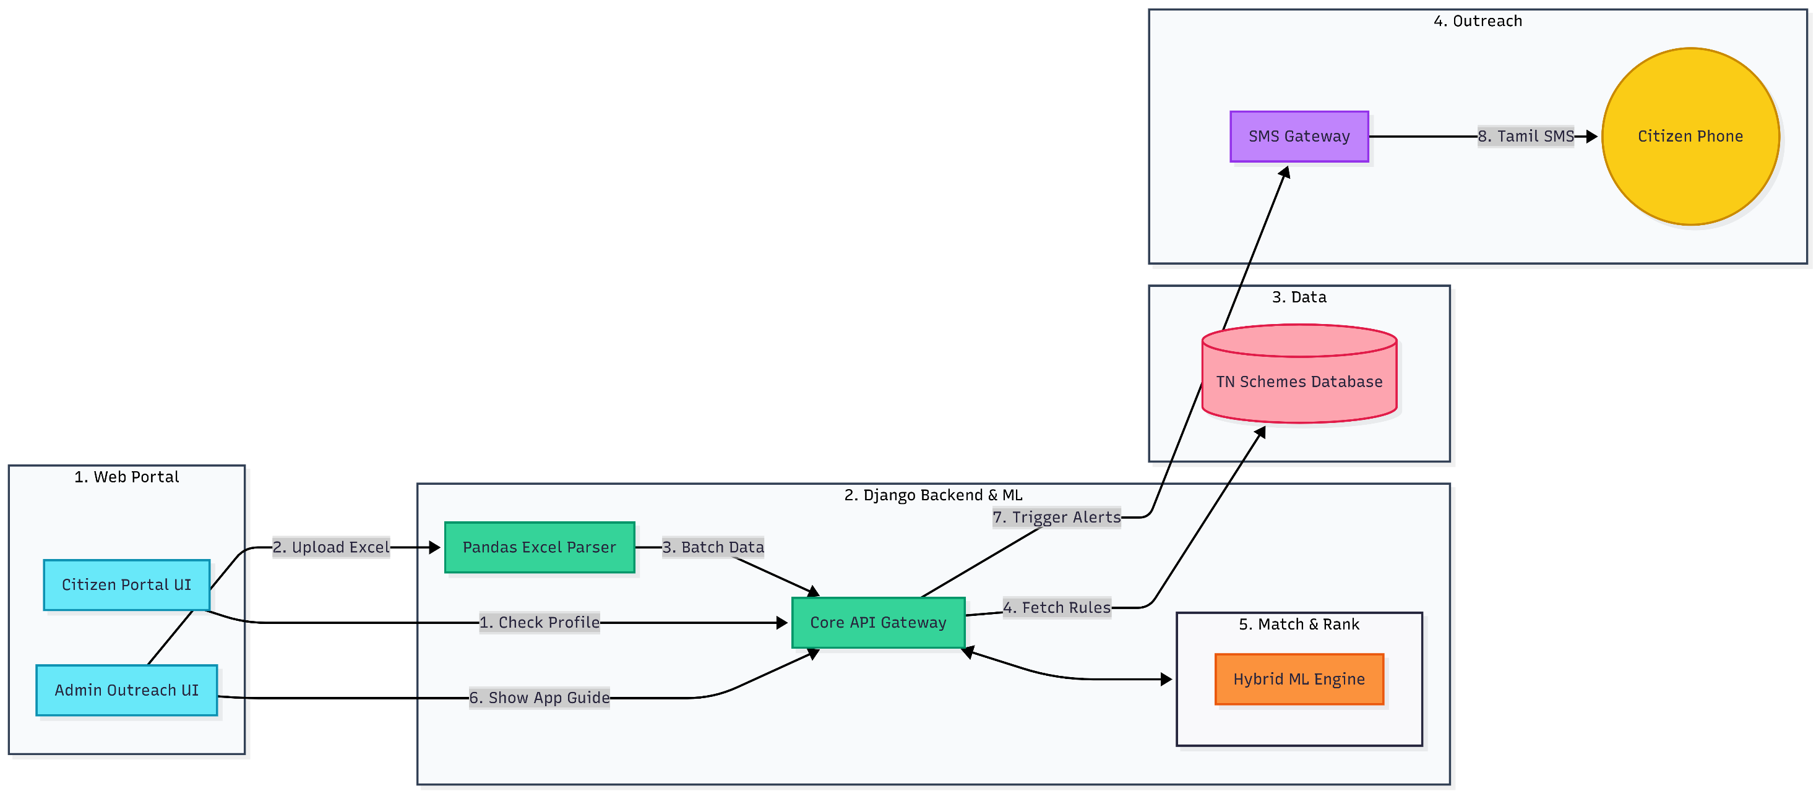
ARCHITECTURE DIAGRAM

Slide 9
THE EVOLUTION OF THITTA-MURASU
From Tool to Platform: Evolving the MVP into a comprehensive, bilingual web portal dedicated entirely to Tamil Nadu Scheme Awareness and Accessibility.
Dual-Persona Dashboard: For Citizens: A public-facing portal to explore domain-based schemes, check personal eligibility, and view step-by-step application guides.
For Officials: A secure backend interface designed for bulk data processing and automated grassroots outreach.

Slide 10
CORE MODULES & FEATURES
Domain-Based Scheme Directory: A categorized, easily navigable repository of state schemes (e.g., Education, Agriculture, Women's Welfare).
The AI Eligibility Engine: An upgraded, highly-tuned Hybrid ML checker where users input demographics to instantly discover their top prioritized schemes.
Actionable Application Guides: Clear, localized instructions detailing exactly what documents are needed and where to apply for each specific scheme.
Bulk Outreach Integration: A dedicated module for Panchayat officials to upload citizen datasets (.xlsx/.csv), instantly cross-reference them against scheme rules, and trigger automated bulk SMS alerts to eligible candidates.

Slide 11
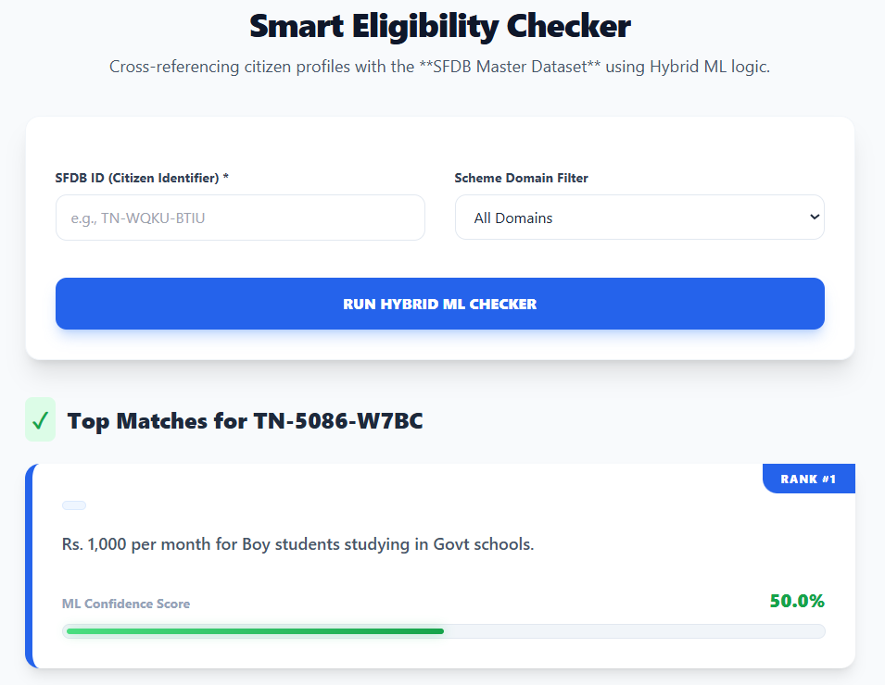
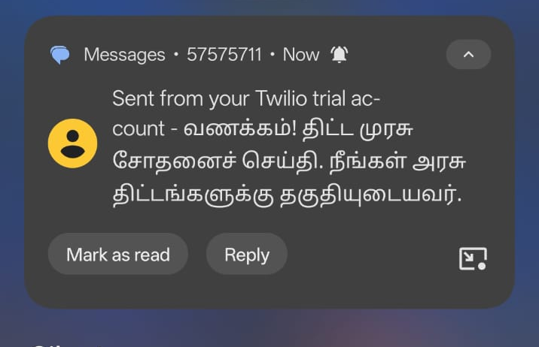
RESULTS

Slide 12
IMPACT AND BENEFITS
Target Audience Impact: Achieves 100% digital inclusion. Reaches the most vulnerable populations (BPL, elders) without them needing to navigate complex government websites.
Social Benefits: Maximizes the utilization of critical welfare programs (housing, education, maternal health) at the grassroots level.
Economic Benefits: Prevents state fund underutilization and injects financial aid directly into the rural village economy.
Administrative Benefits: Drastically reduces manual rulebook-checking and workload for local officers.

Slide 13
FUTURE ROADMAP :
Real-Time API Integration: Transitioning from manual Excel uploads to a live REST API sync with the SFDB for zero-latency data processing.
Fully Automated Outreach: Implementing self-triggering logic where the SMS Gateway dispatches alerts the moment a citizen becomes eligible, removing all manual intervention.
Voice-First Accessibility: Deploying AI-Voice Bots (IVR) in local Tamil dialects to assist illiterate citizens and those without smartphones.
Predictive Budgeting: Utilizing ML Match trends to forecast future scheme demand, enabling the government to allocate welfare funds with data-driven precision.

Slide 14
Thank you

